Slide 1


Slide 4
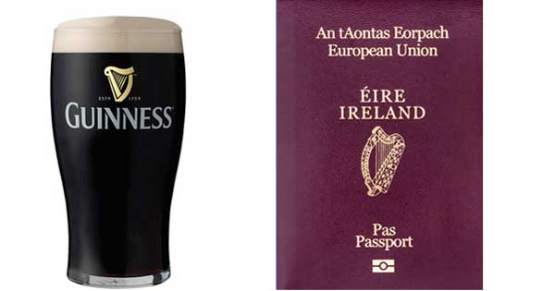
IRELAND
A few facts….
Official name: Republic of Ireland
Capital: Dublin
Irish name: Éire
National symbol: Irish harp facing left
National animal: Red deer
Patron saint: St Patrick

Slide 5
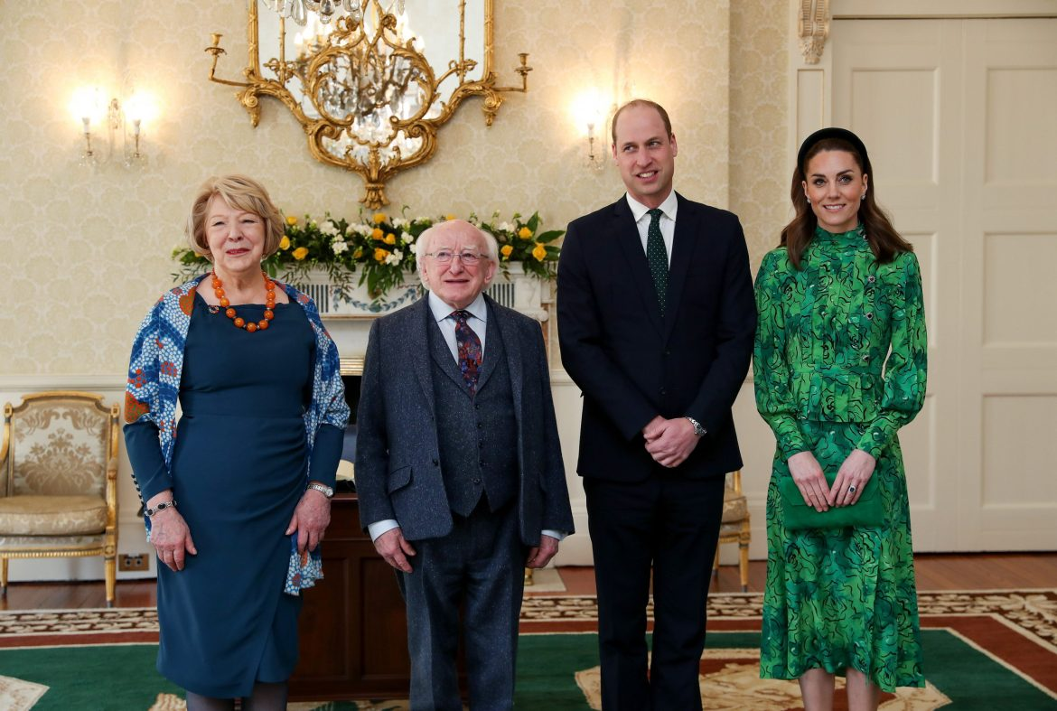
Official languages: English, Irish
Population: 4,834,000
Area: 27,133 sq mi (70.273 sq km)
President: Michael D Higgins
Highest mountain: Carrauntoohil
3,405 ft (1.038 m)
National day: March 17th
Irish life expectancy: 81 years

Slide 6
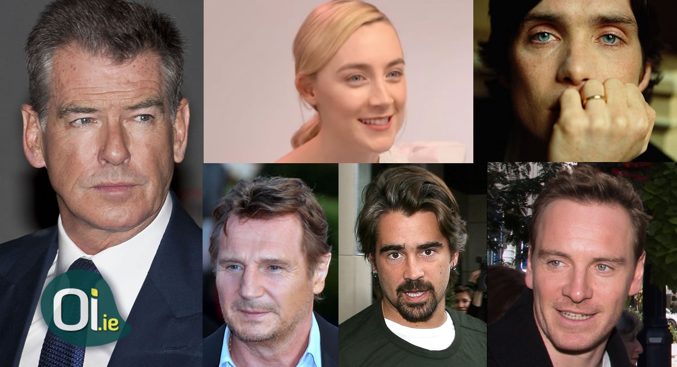

Slide 7
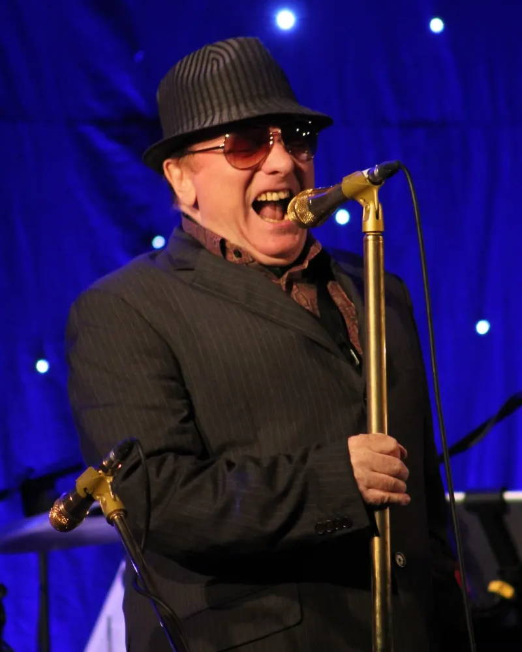
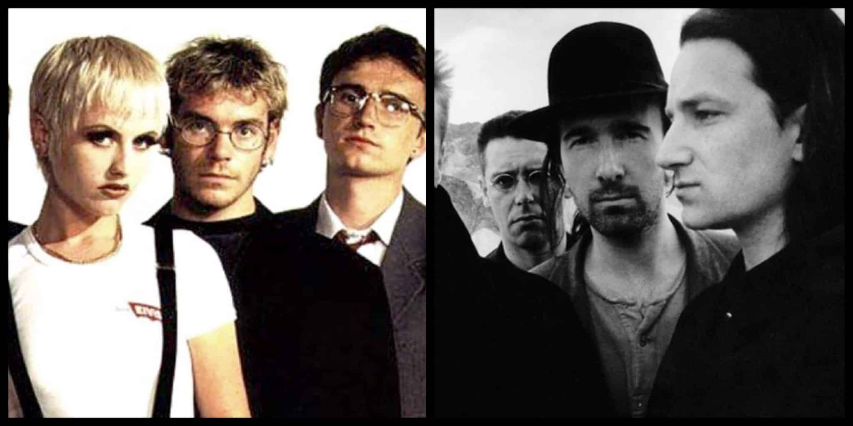
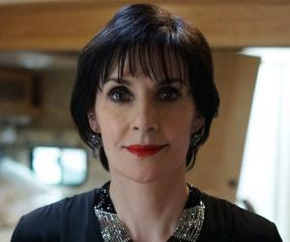
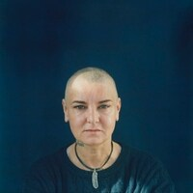
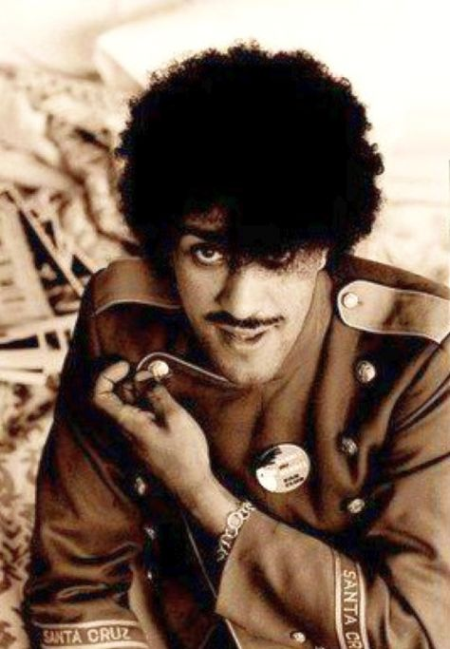
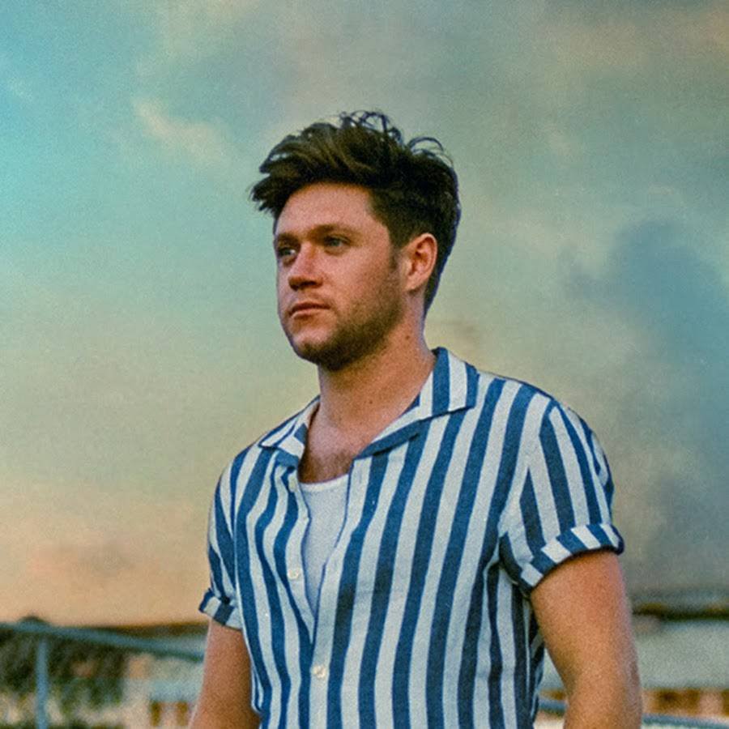
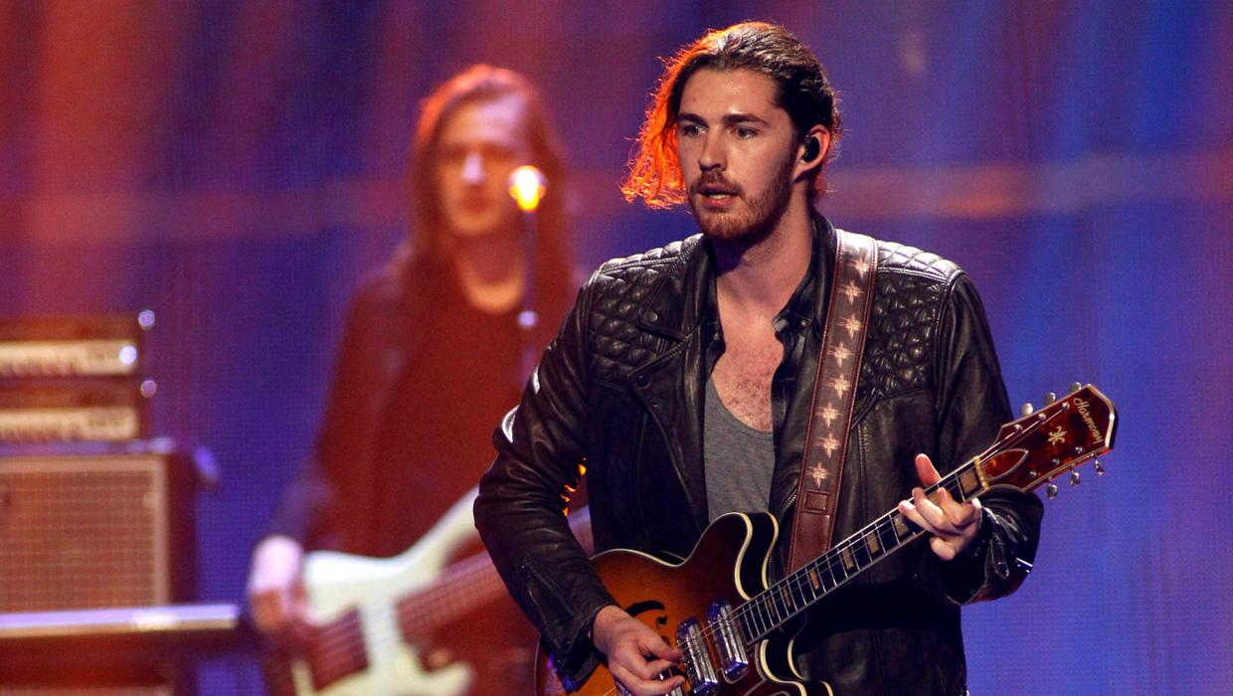

Slide 8
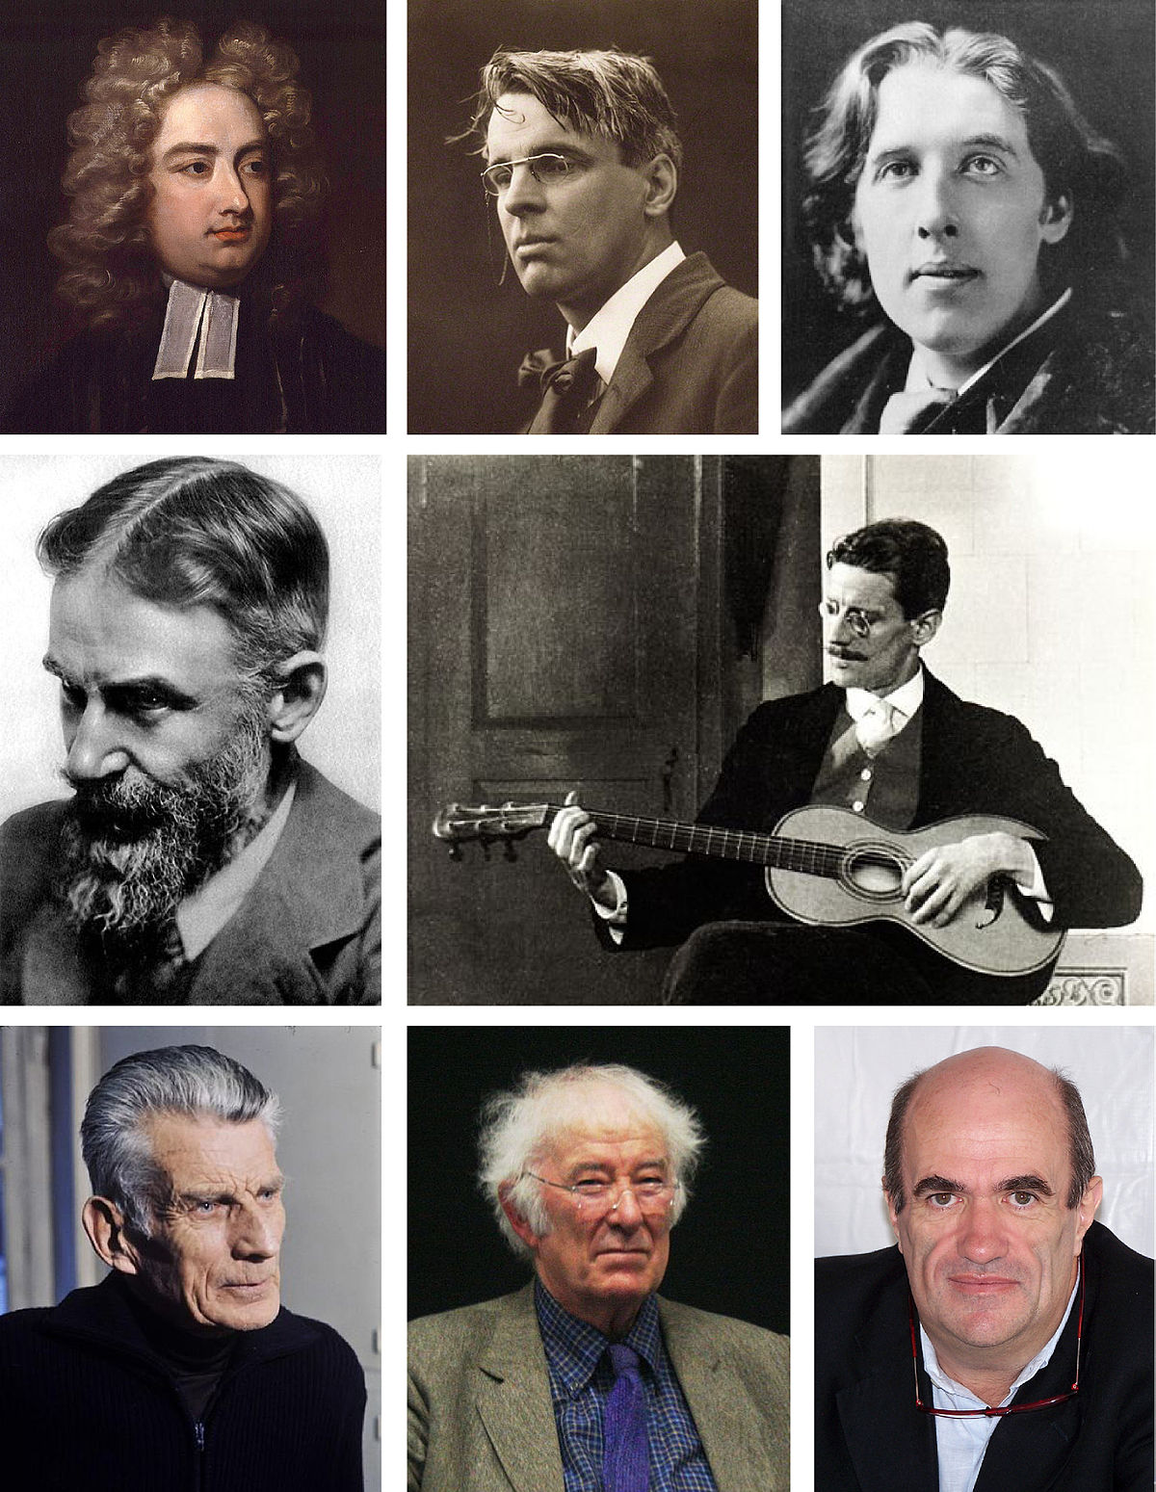

Slide 9
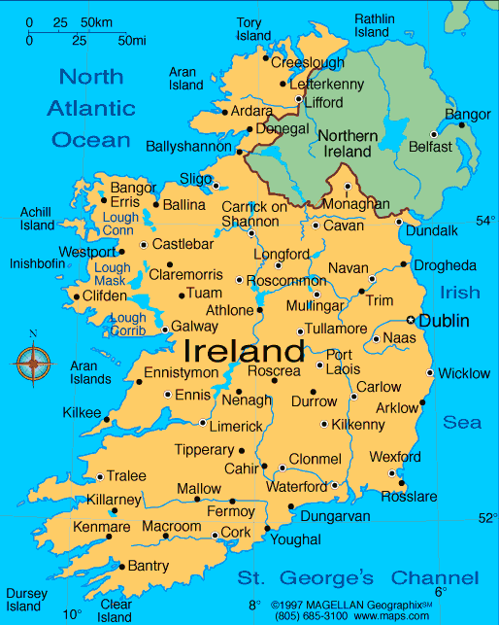

Slide 10
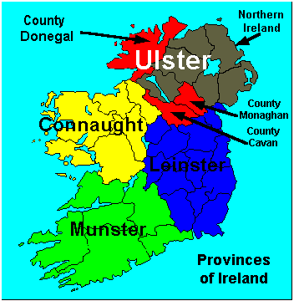

Slide 11
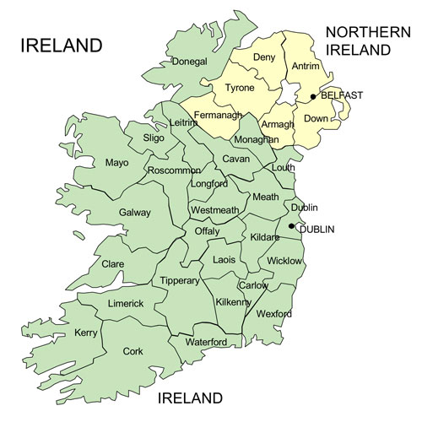

Slide 12
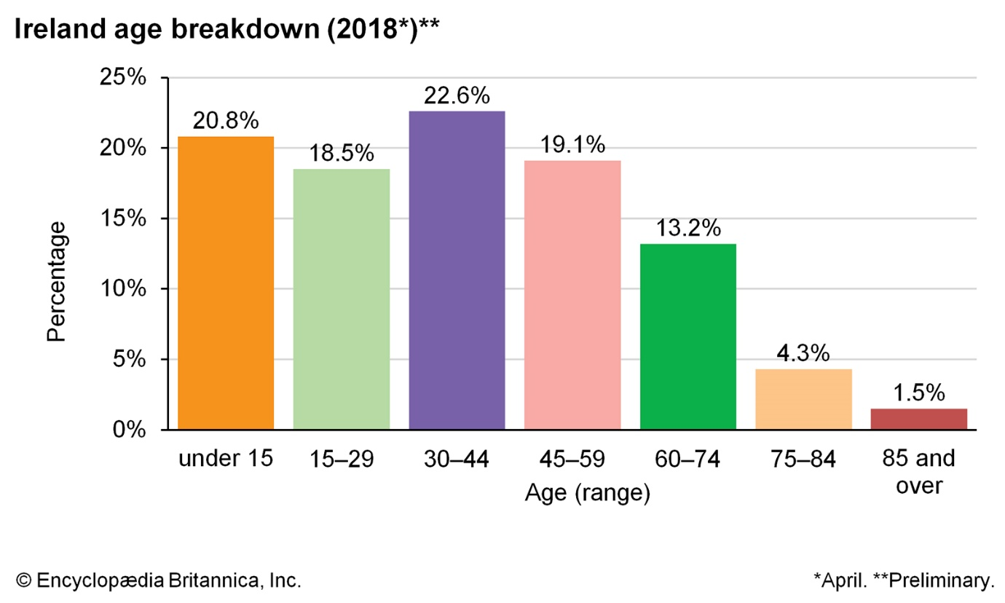

Slide 13
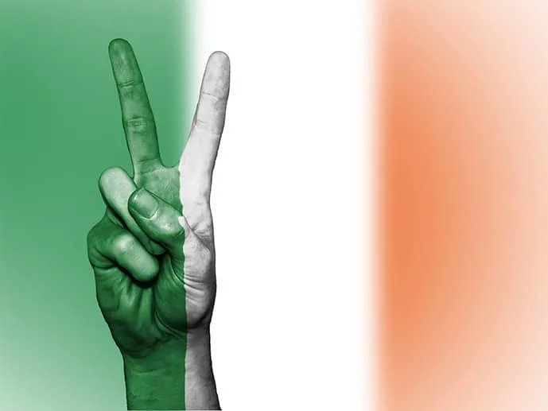
The Irish Flag symbolises peace between different religions and cultures.

Slide 14
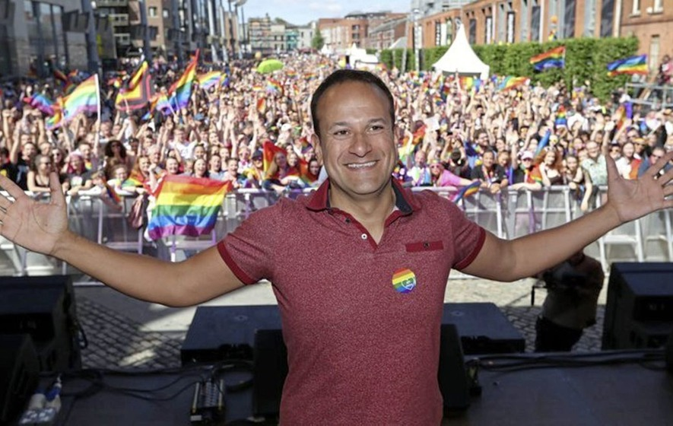
Ireland voted by a huge majority to legalise same-sex marriage, becoming the first country in the world to do so by popular vote in a move hailed as a social revolution and welcomed around the world.
2015

Slide 15
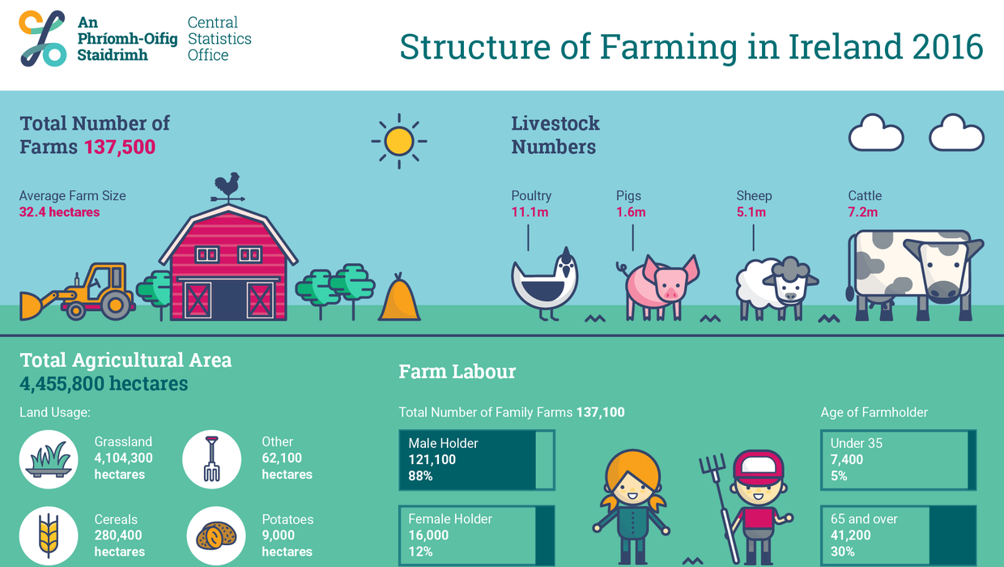

Slide 16
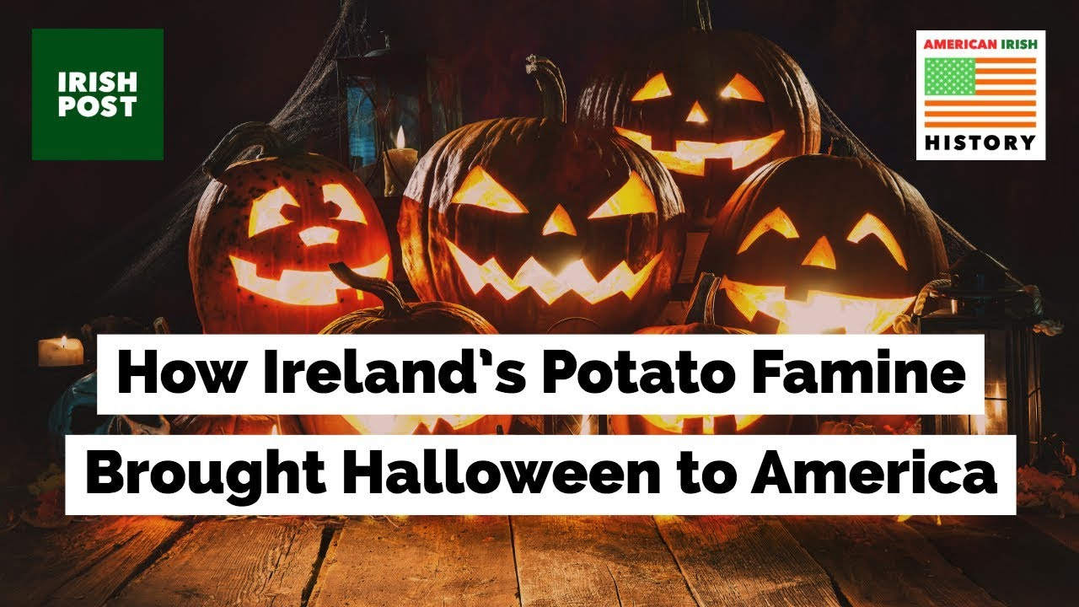
Irish Halloween Traditions - YouTube

Slide 17
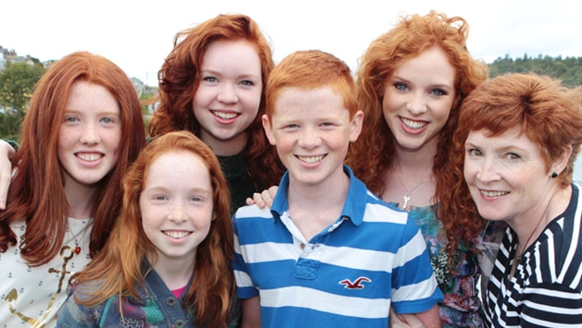
About 9% of the Irish have red hair
Contrary to popular belief, most Irish people do not have red hair. In fact, only 9% of all Irish population are red-headed.
The majority have either brown or blonde hair. However, this is an interesting Ireland fact because although red locks account for less than 10% of the country’s total population, it’s still much more than the world average of 2%.

Slide 18
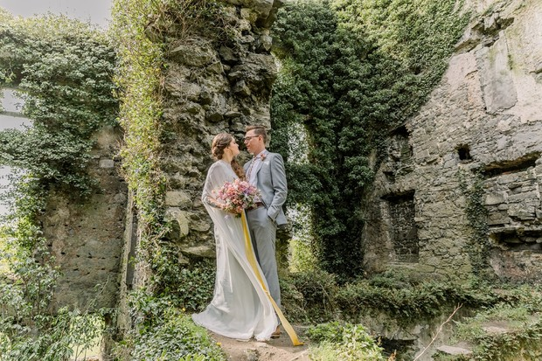
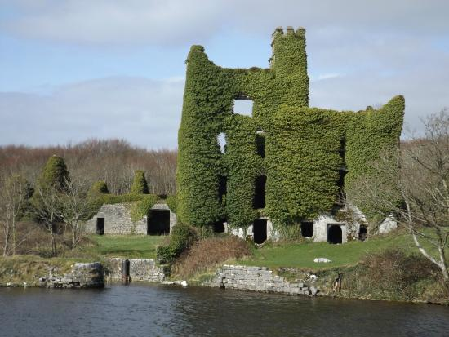
There are over 30,000 castles and ruins in Ireland
It’s estimated that Ireland has over 30,000 castles and castle ruins dotted all over the Irish landscape.

Slide 19
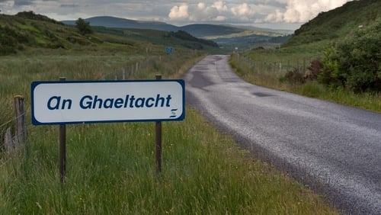
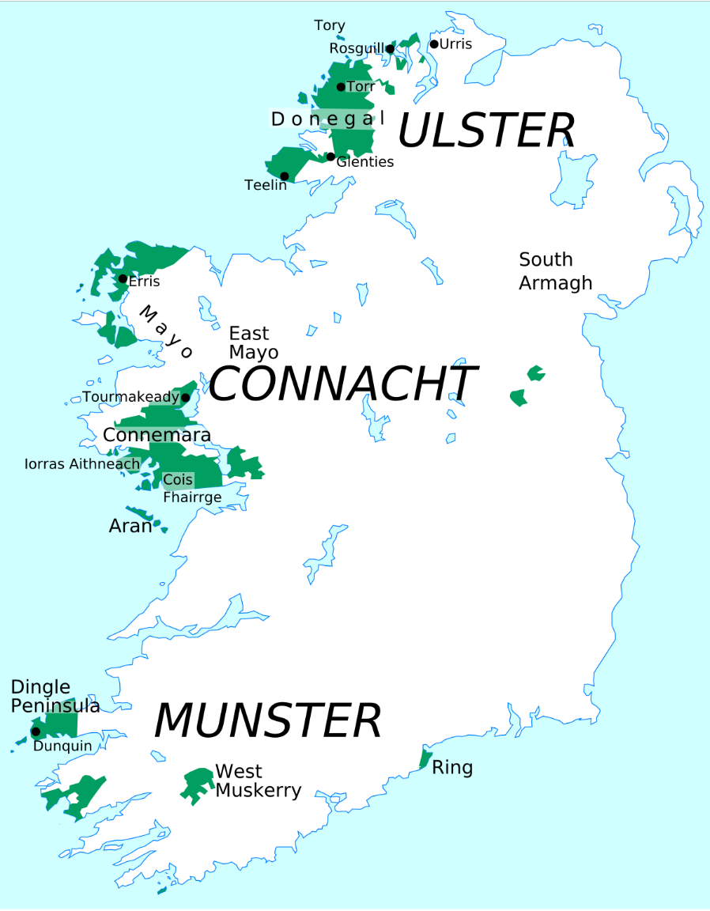


Slide 21
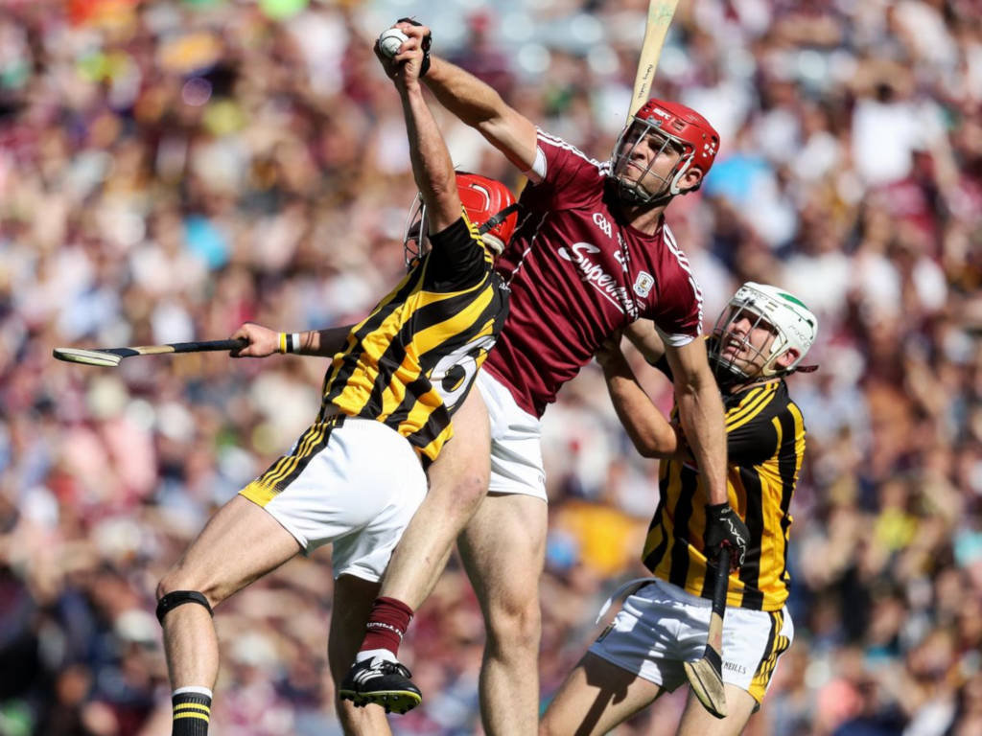
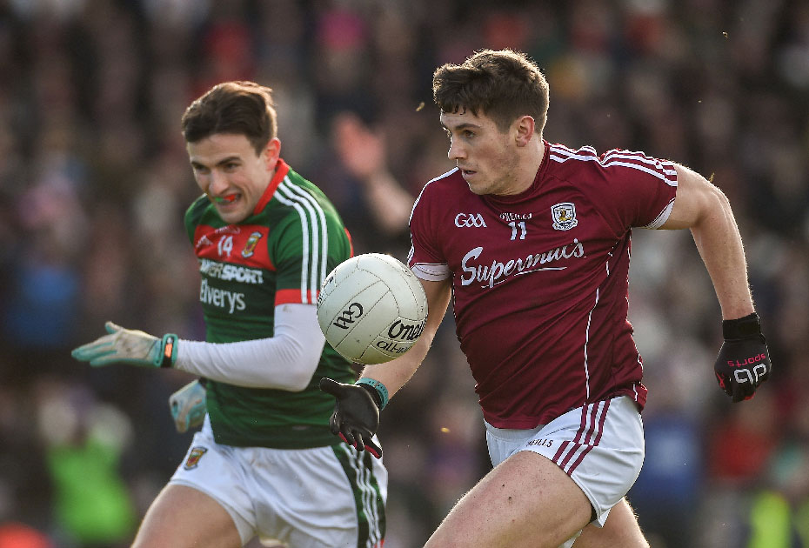

Slide 22
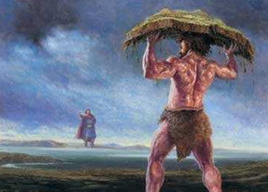
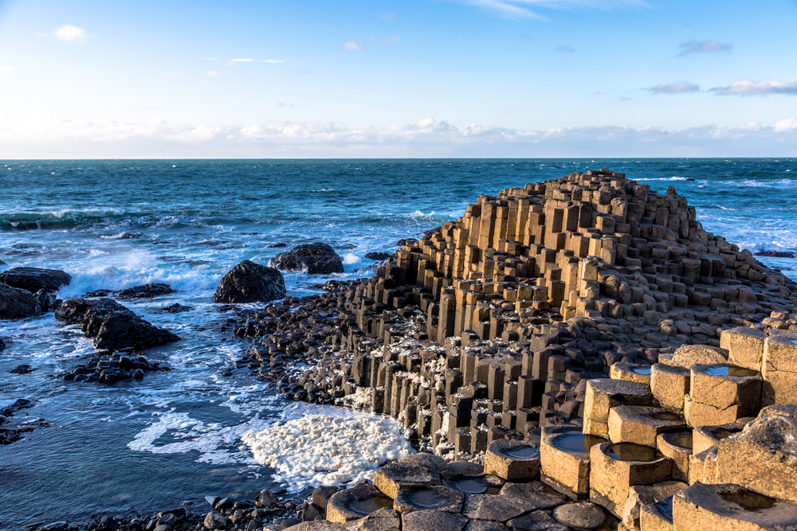
Giants Causeway Visitors Centre - The Myth of Finn McCool on Vimeo

